Slide 1
工作汇报
2018年10月23日

Slide 2
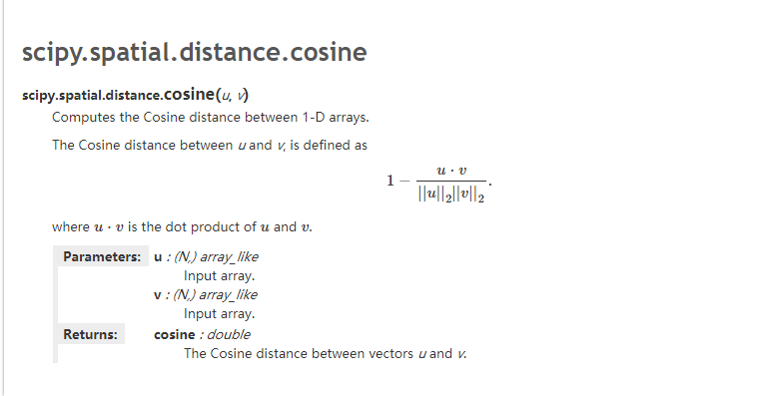
Compute cosine distance
Notes:
采用不同的特征表达形式可以构造出不同的滤波组

Slide 3
Model configuration
Train:
Batch size:400
Uniform_init_scale:random initscale
Learning_rate 0.0005 The learning rate of Adam
Uniform_init_scale 0.1 The random init scale
Clip_gradient_norm 5.0 gradient clipping norm,to protect gradient explosion
Save_model_secs 600 save model ever 600s
Save_summaries_secs:600 save log ever 600s
Nepochs 1 number of epochs
Num_train_inst Number of training instances
Max_ckpts 5 max number of ckpts to keep
Num_input_reader_threads 1 input data reader threads
Learning_rate_decay_steps 400000 learning rate decay every 400000 steps
sequence_length 30 Max sentence length considered
Context_size 1 Prediction context size
Notes:
采用不同的特征表达形式可以构造出不同的滤波组

Slide 4
Data processing
Total sentences: 3049353
1.Delete the sentences which has less than three words (2775989)
2.Encode and save to a npy file
3.Divided into 10 sentences aggregation
4.Make cluster for every sentences aggregation by autotuned algorithm in flann
5.For every test sentences ,find ten nearest neighbours,get their cos similarity
6.Compare the meaning
Notes:
采用不同的特征表达形式可以构造出不同的滤波组

Slide 5
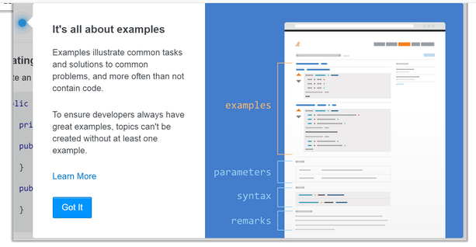
The diagram shows a topics page：contains many examples.
1146 tags, a tag contains a lot of topics, and a topic contains a lot of examples.
Notes:
采用不同的特征表达形式可以构造出不同的滤波组

Slide 6
For each tag the documentation is organized in topics which contain examples explaining the topic, followed by Syntax, Parameters and Remarks sections. The Syntax section contains concise syntax reference documentation while the Parameters one may include information about the parameters of a constructor or a method. The Remarks section is optional.
eg, the Java Language tag has the largest number of topics(185) , including Arrays, Streams, Strings, Generics, Lambda Expressions, and others. The Arrays topic includes 18 examples showing how to create, sort, iterate, compare, convert or perform other operations with arrays. Each example usually contains some text and code snippets demonstrating the use of the respective technology feature.
Notes:
采用不同的特征表达形式可以构造出不同的滤波组

Slide 7
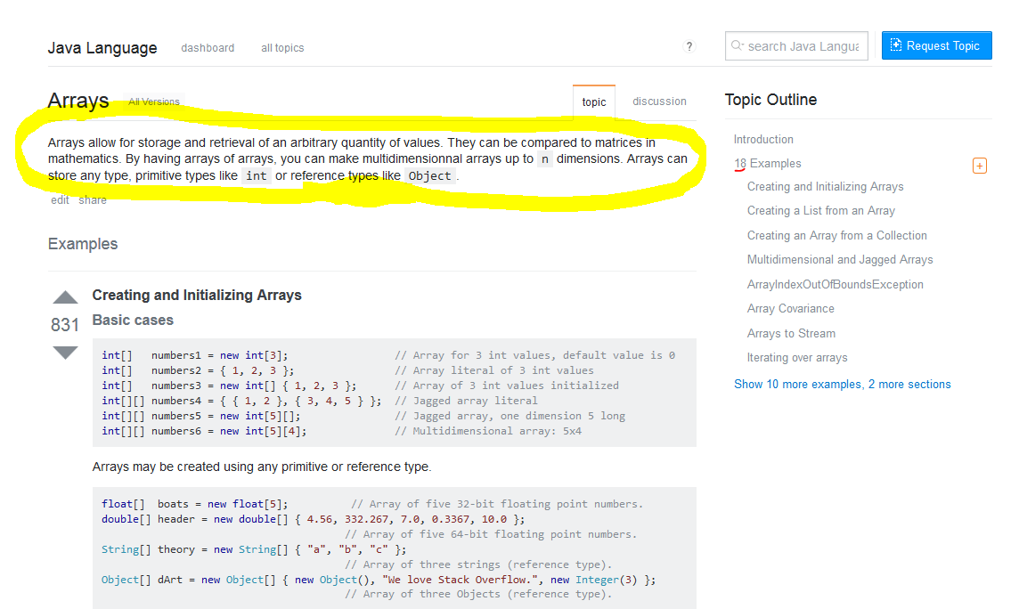

Slide 8
The data source used for clauses:
1.intruductionMarkdown fields in topics.json
2.BodyHtml fields in example.json

Slide 9
Last week's question
Doctagversions .json
introduce：Version types of each tag in the document
total number：5956
tags number：1146
795 tags have no version information
Not all tags have version Numbers,
eg:linux,gwt
topics.json
total number:8038
python number:202
20 tags don't have topics，Topic contains 1126 tags，on average, one topics contains eight topics。
Notes:
采用不同的特征表达形式可以构造出不同的滤波组

Slide 10
定义类：
1. a stack is a container of objects that are inserted and removed according to the last-in first-out lifo principle.
2. flask is a python micro web framework used to run major websites including pintrest twilio and linkedin.
3. pyglet is a python module used for visuals and sound.
4. decorator functions are software design patterns.

Slide 11
2比较：
1.a comprehension or generator expression is more readable more powerful and more efficient than filter or ifilter.
2.this module will answer question such as is it faster to do a list comprehension or use the built-in list when transforming a set into a list.
3.python 2.7 is backwards-compatible with most earlier versions of python and can run python code from most 1.x and 2.x versions of python unchanged.
4.code utilizing classes is generally easier to read understand and maintain
5.the capitalization of the tkinter module is different between python 2 and 3.

Slide 12
包含：
1.a linked list is a collection of nodes each made up of a reference and a value.
2，linked lists can be used to implement more complex data structures like lists stacks queues and associative arrays.
3.pyaudio provides python bindings for portaudio the cross-platform audio io library .
4.python offers a wide variety of string formatting methods which are outlined in this topic.
5.regular expressions are combinations of characters that are interpreted as rules for matching substrings.

Slide 13
并列：
1.a list can be a collection of either homogeneous or heterogeneous elements and may contain ints strings or other lists.
2.threads allow multiple processes to flow independent of each other.
3.the base64 module is part of the standard library which means it installs along with python.

Slide 14
否定意义：
1.python variables do not need an explicit declaration to reserve memory space.
2.functions simplify the coding process prevent redundant logic and make the code easier to follow.
3.unlike other languages where file input and output requires complex reading and writing objects python simplifies the process only needing commands to open read write and close the filelinked lists can be used to implement more complex data structures like lists stacks queues and associative arrays.
3.most exceptions are not handled by programs.
4.here in stack overflow we often see duplicates talking about the same errors importerror no module named syntaxerror invalid syntax or nameerror name.
5.avoiding the cross-platform encoding hell when using python s built-in open it is best-practice to always pass the encoding argument if you intend your code to be run cross-platform.

Slide 15
Q&A

